Slide 1

Master Thesis Presentation
“Decentralized Information Gathering
with Continuous and very large
Discrete Observation Spaces”
Caus Danu
July 8th 2020

Slide 2
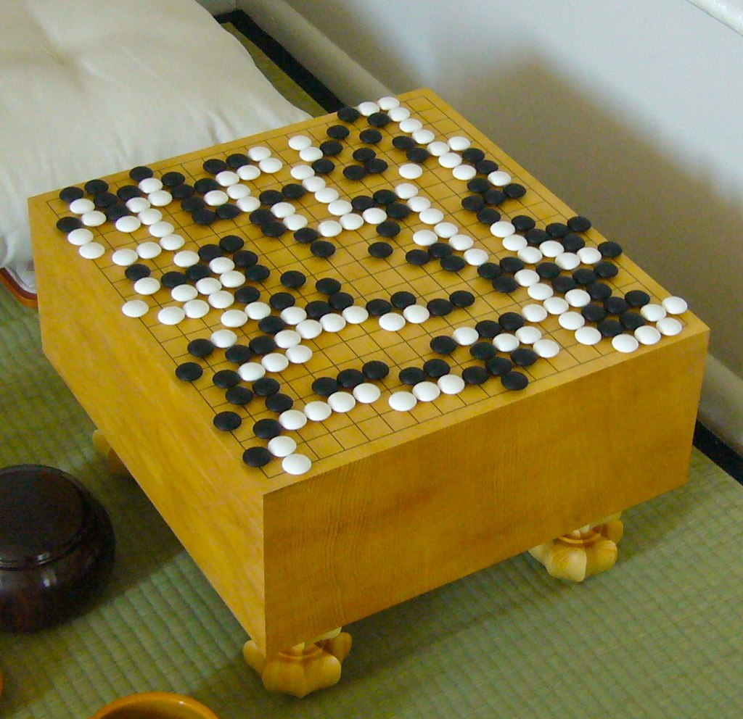
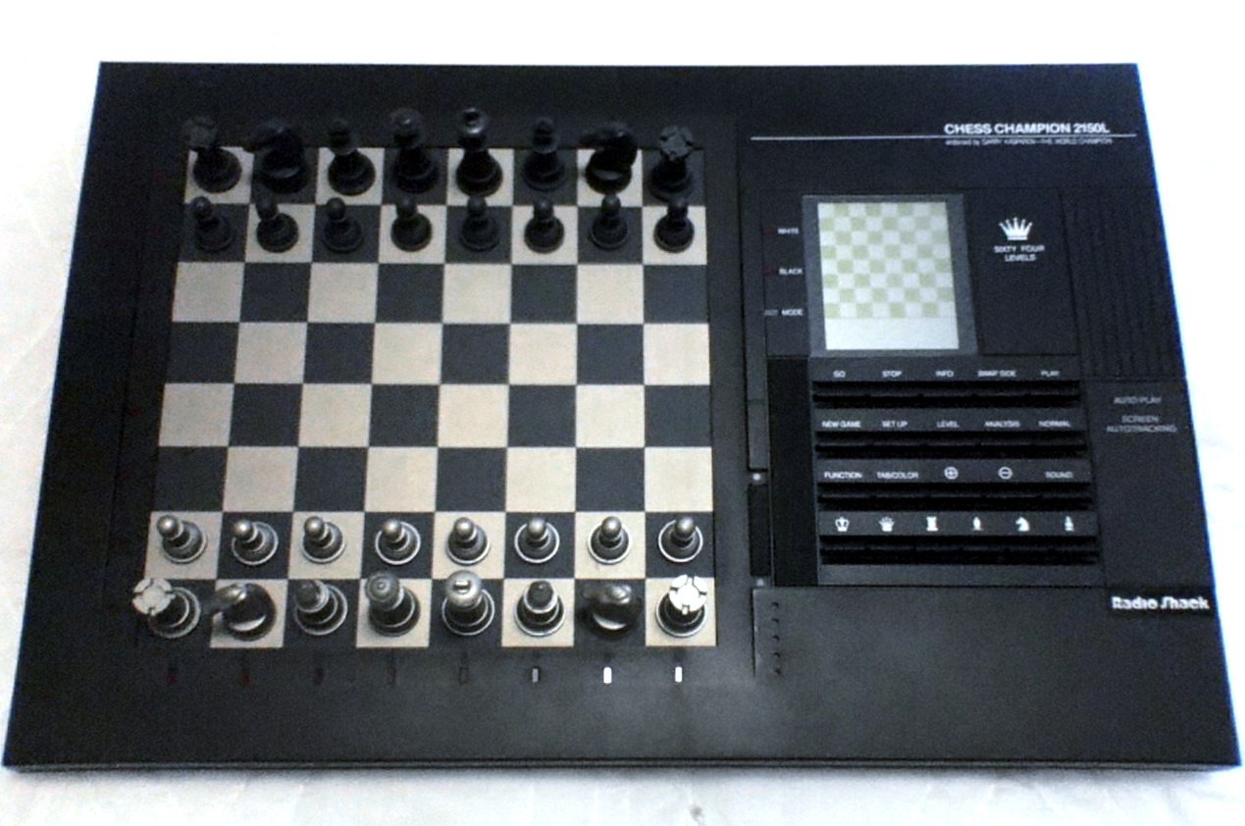
Planning
Cambridge Dictionary:
“The act of deciding how to do something”
“The process of planning activities or events in an organized way so that
they are successful or happen on time”
The game of Go. Courtesy of [2]
Notice the game boards. No sophisticated perception ability is required from a computer other than understanding a uniform grid of cells. Hence, the computer cares almost exclusively about optimal action sequences given the time constraints.
Chess-playing computer. Courtesy of [1]

Slide 3

Perception
Cambridge Dictionary:
“An awareness of things through the physical senses, especially sight”
“A belief or opinion, often held by many people and based on how things seem”
Courtesy of [3]
Goal:
Find a Policy, i.e. a mapping between the perceived observations and appropriate actions to take, such that the task outcome is optimized with respect to time and utility.

Slide 4
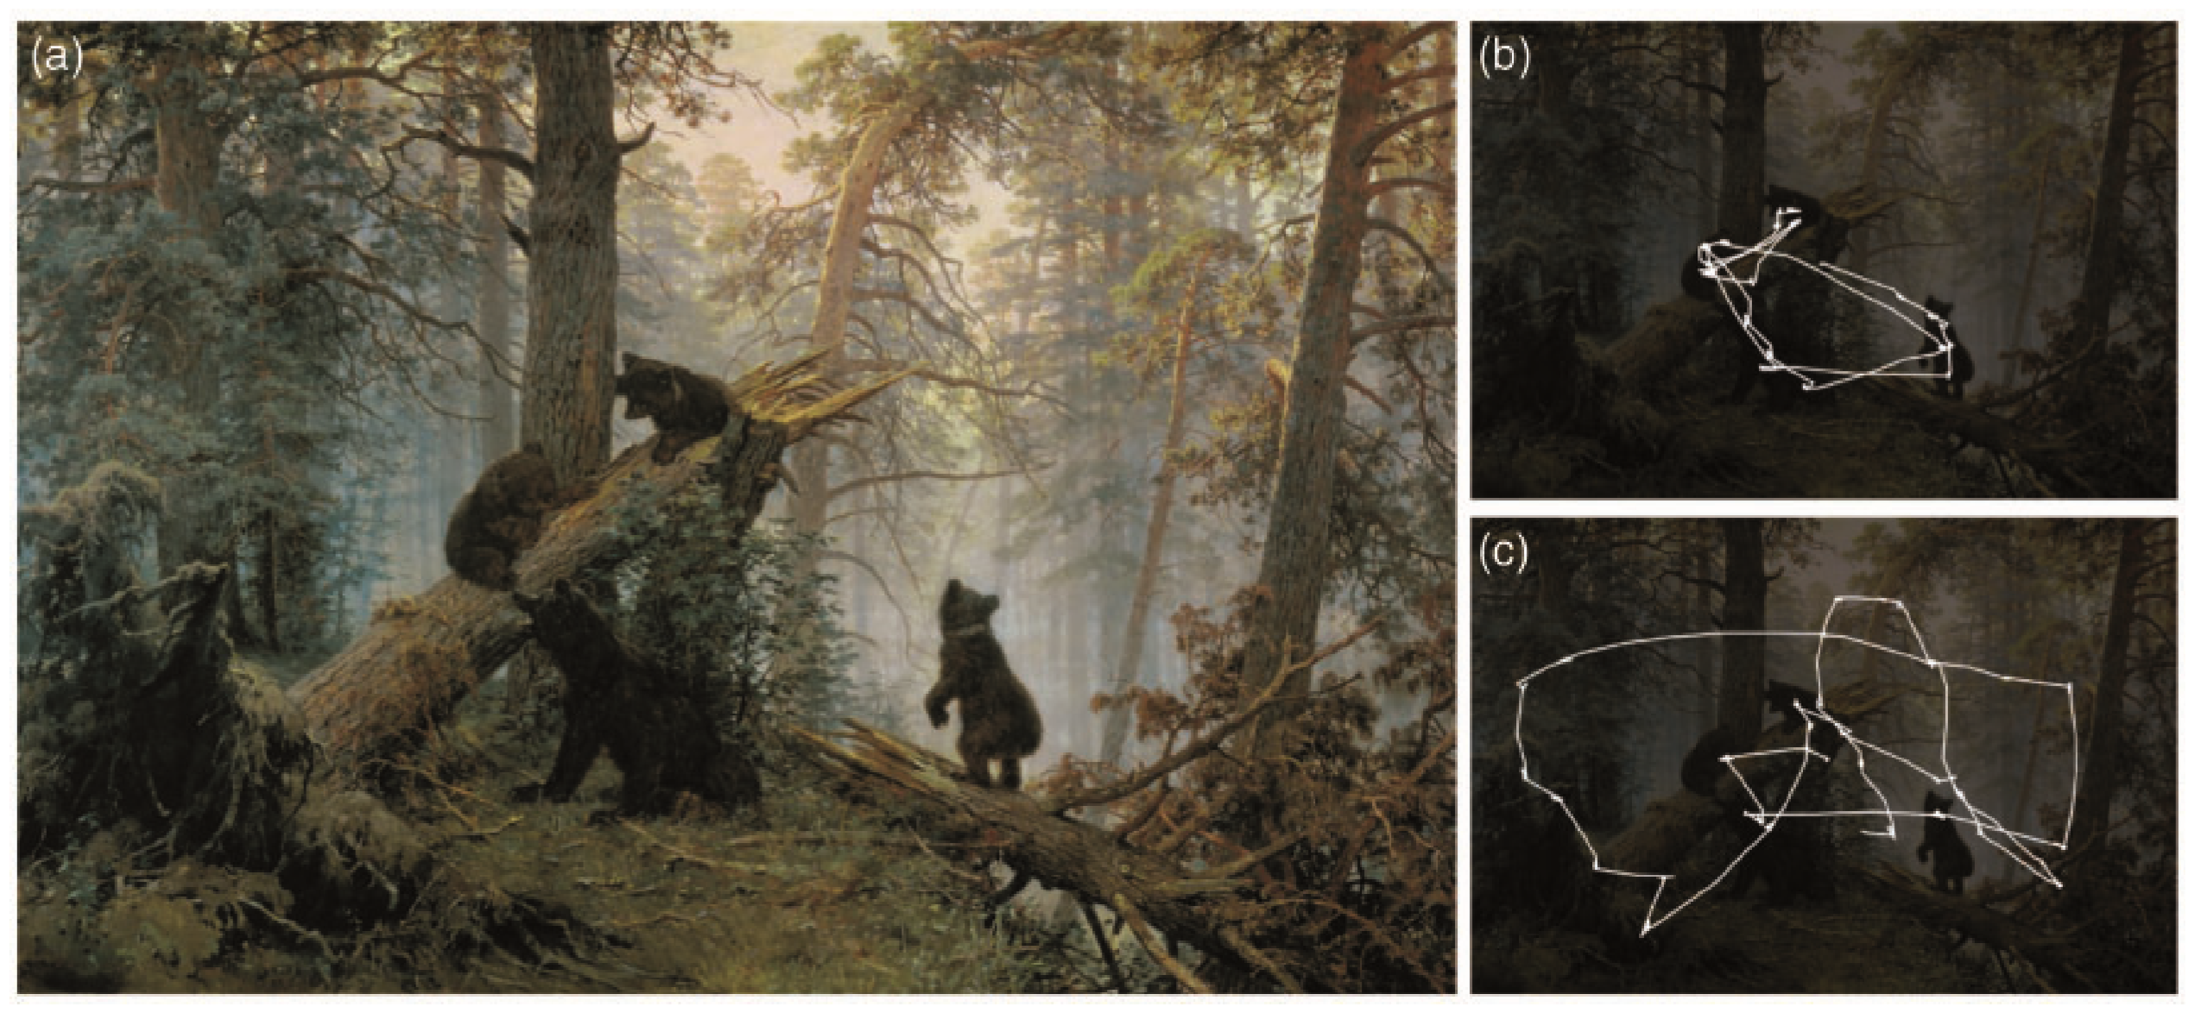
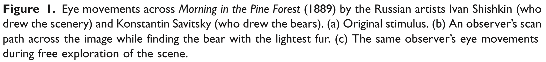
Joint Perception and Planning
An example of “Visual Search”. Courtesy of [4]

Slide 5
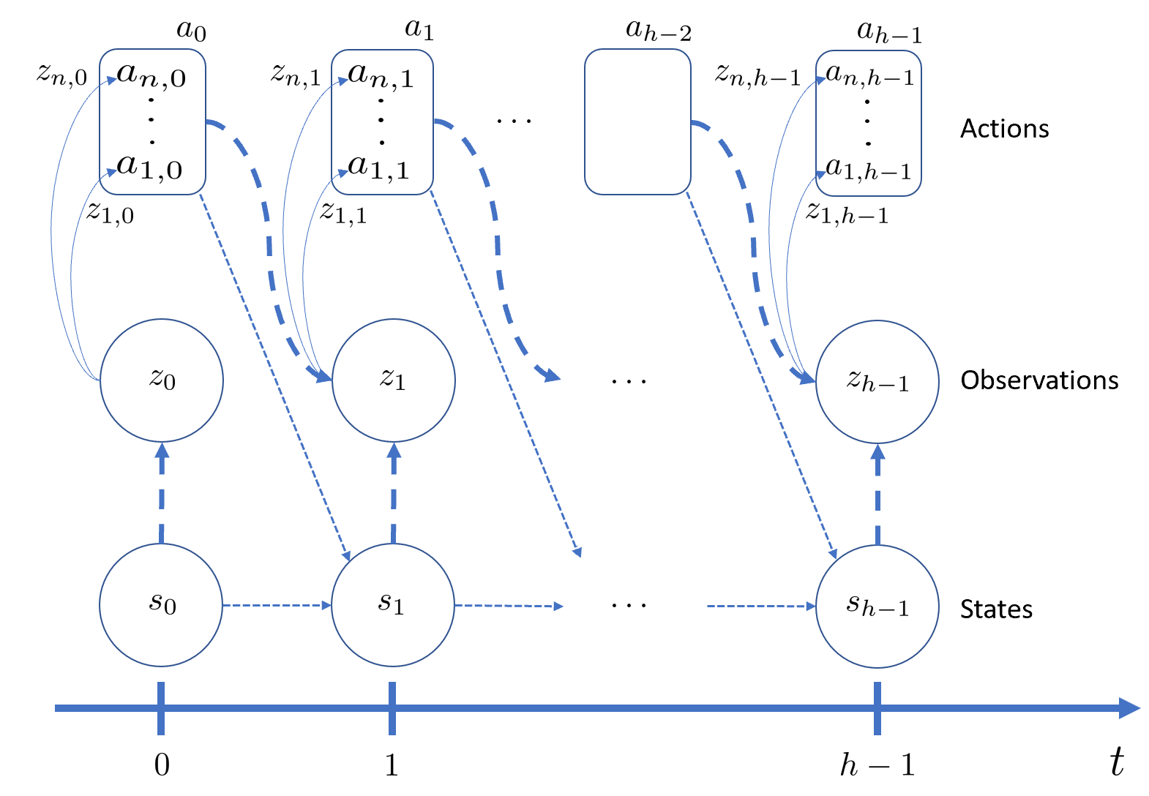

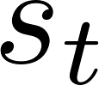
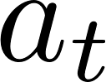
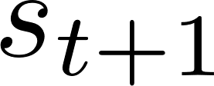
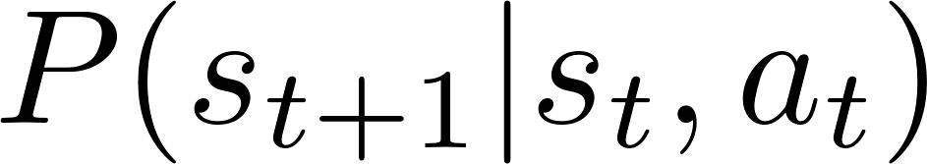
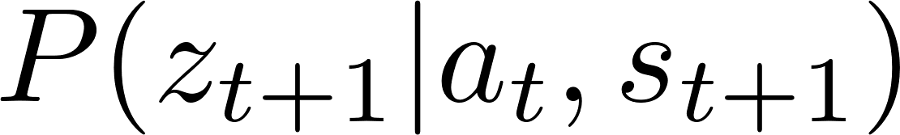
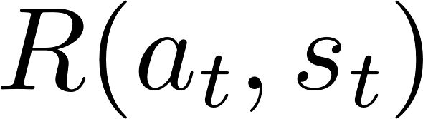
Decentralized POMDP
At time the environment has a state
Each agent takes a local action, which is a component of a joint actions vector
The environment transitions to the next state according to the transition model
The environment then emits a joint observation according to the observation model
Each agent has access to its own local observation
All agents receive a common reward
Dec-POMDP Framework. Inspired by and adapted from [5]

Slide 6
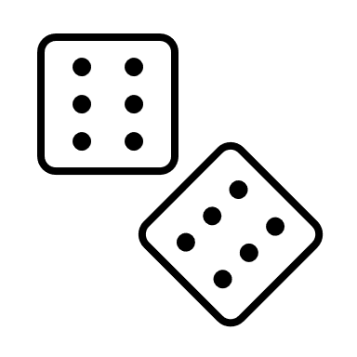

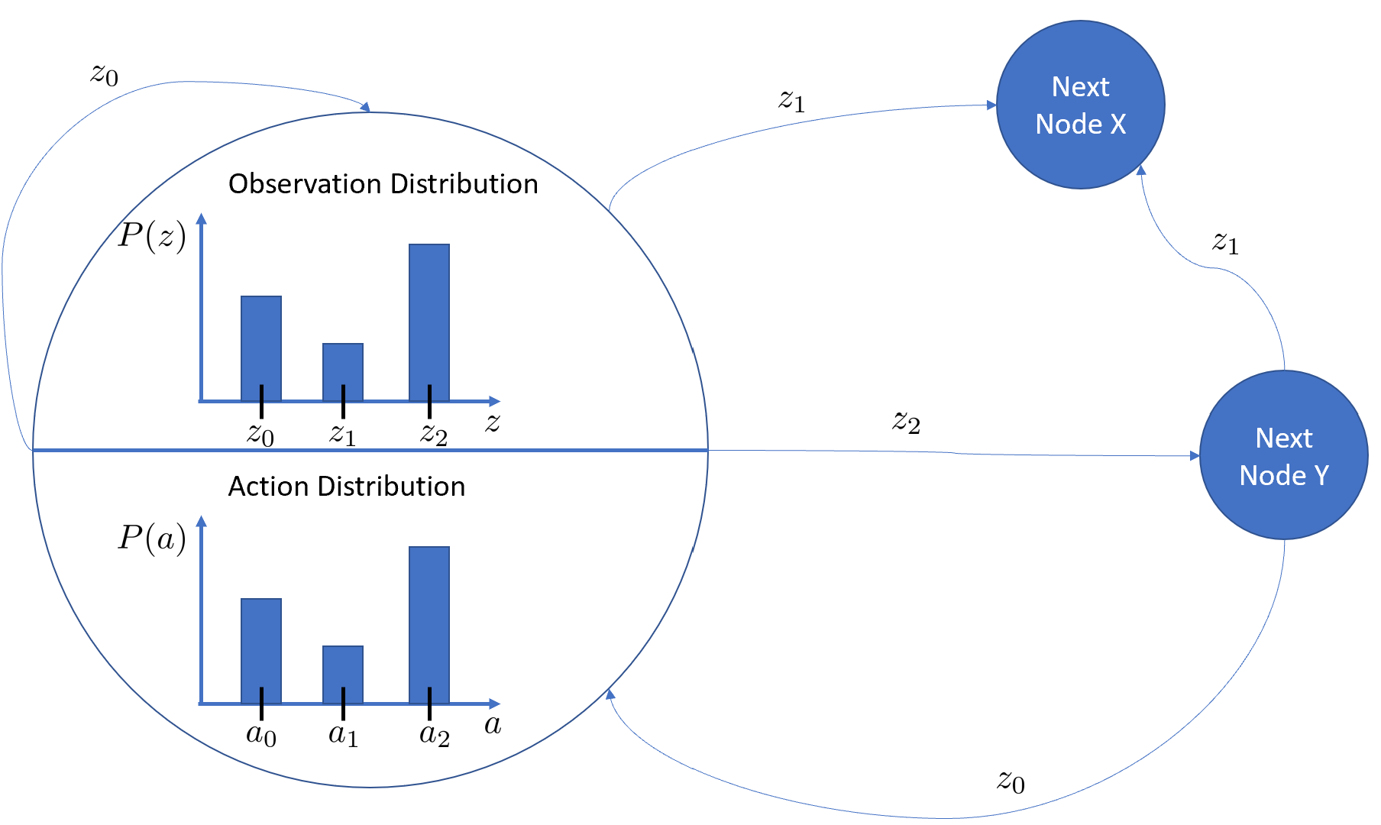
G-DICE
Peculiarities of G-DICE:
Observations are discrete
Actions are discrete
G-DICE Gist:
Sample an action in a current node and carry it out
Receive an observation at the next time step
Based on the current node and the observation, transition to the next node
Graph data structure with each node containing action and observation distributions

Slide 7
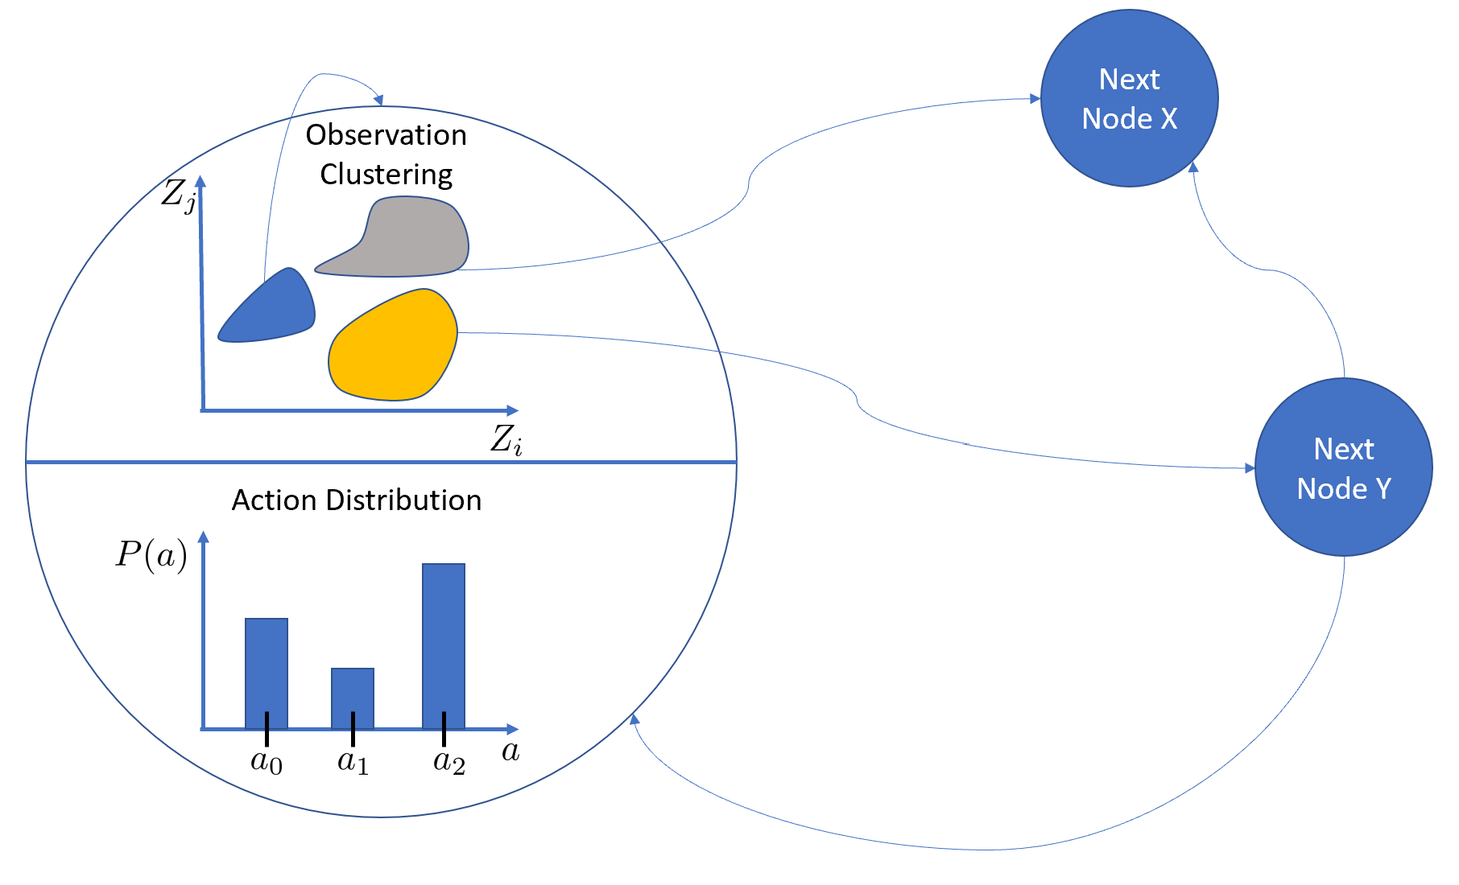
Continuous Observation G-DICE
Recent methods from other works:
Radial Basis functions
Beta functions
Dirichlet functions
Interesting to research:
Deep-learning within graph nodes
Cluster continuous observations using machine learning techniques

Slide 8
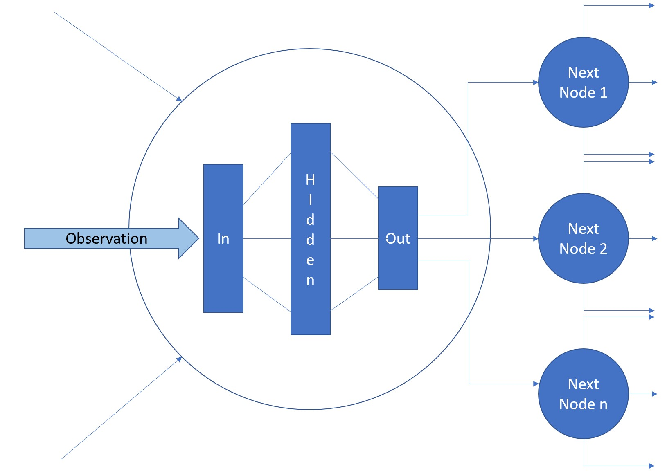
New proposal: COGNet-DICE
Methodology details:
Thresholding
Avoidance of policy degeneration through “single gene” mutation
Entropy Injection for exploration purposes
Not used but very desirable:
Experience replay
Leverage deep learning and embed neural networks in graph nodes

Slide 9
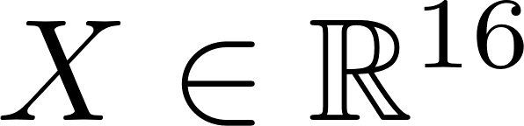
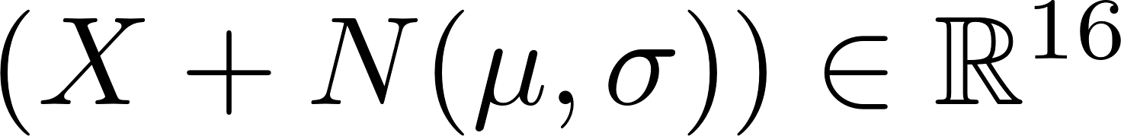
Scaling to higher dimensions
1D Observation
Neural
Net
Encoded COGNet-DICE
2 COGNet-DICE flavours
Simulator
2D COGNet-DICE
2D Observation
Neural
Net
Encode
Sample
Decode
Variational Autoencoder
Reasons and Expectations:
Lower training space and time complexity => Efficiency
Robustness to noise in the online test application phase => Transfer Learning

Slide 10
Research Questions
Can a graph-based direct cross-entropy algorithm be combined with neural networks and successfully trained to directly couple the tasks of perception and planning ?
If yes, how does such an algorithm perform in the case of continuous observations and states ? In particular: is such an algorithm useful for source localization problems with continuous observations and states ?
And lastly, does this algorithm scale to very high-dimensional discrete inputs, such as images, when we use a lossy compression scheme derived with the help of a Variational Autoencoder ?

Slide 11

Rollouts
Run many simulations to collect data:
Current Node
Sampled Action
Observation
Next Node
Apply “cross-entropy method” to make sense out of the collected data
Rollout <=> Simulation

Slide 12

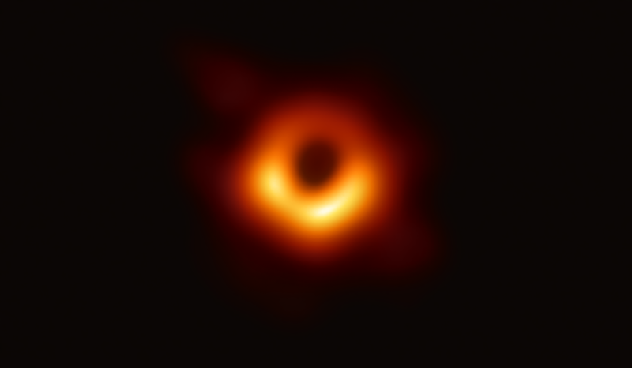
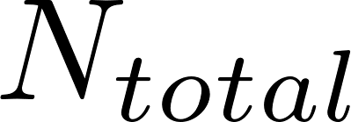

Entropy measures uncertainty
Cross-Entropy Learning Method:
Sample policy samples using simulation rollouts
Estimate model using only a subset of the best samples that result in high reward
Courtesy of [6]
Intuition:
By filtering the best samples, we put emphasis only on the useful information that we want to extract from the world

Slide 13

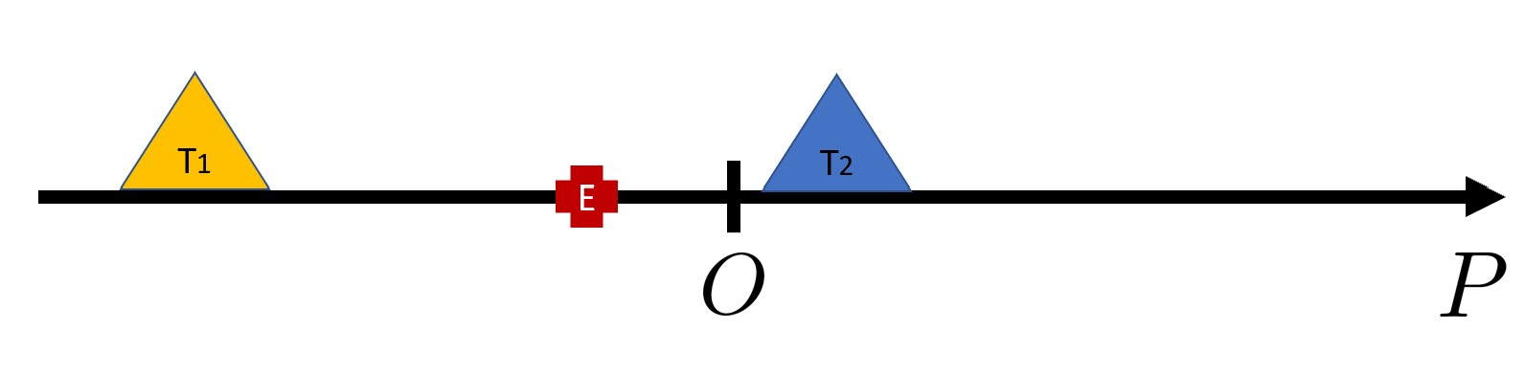


Tagging Simulation
Intention: Emulate a dynamic source localization problem in a 1D world
Catch me if you can !

Slide 14
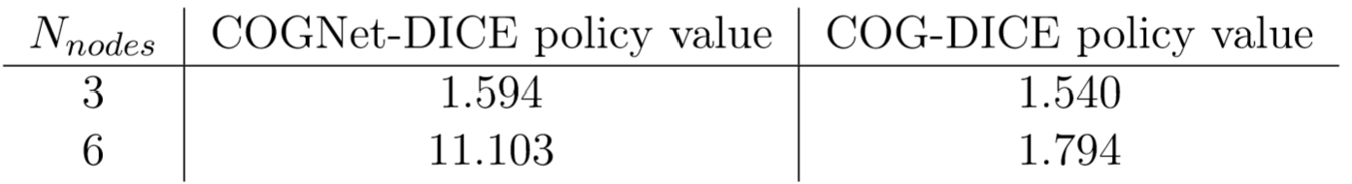
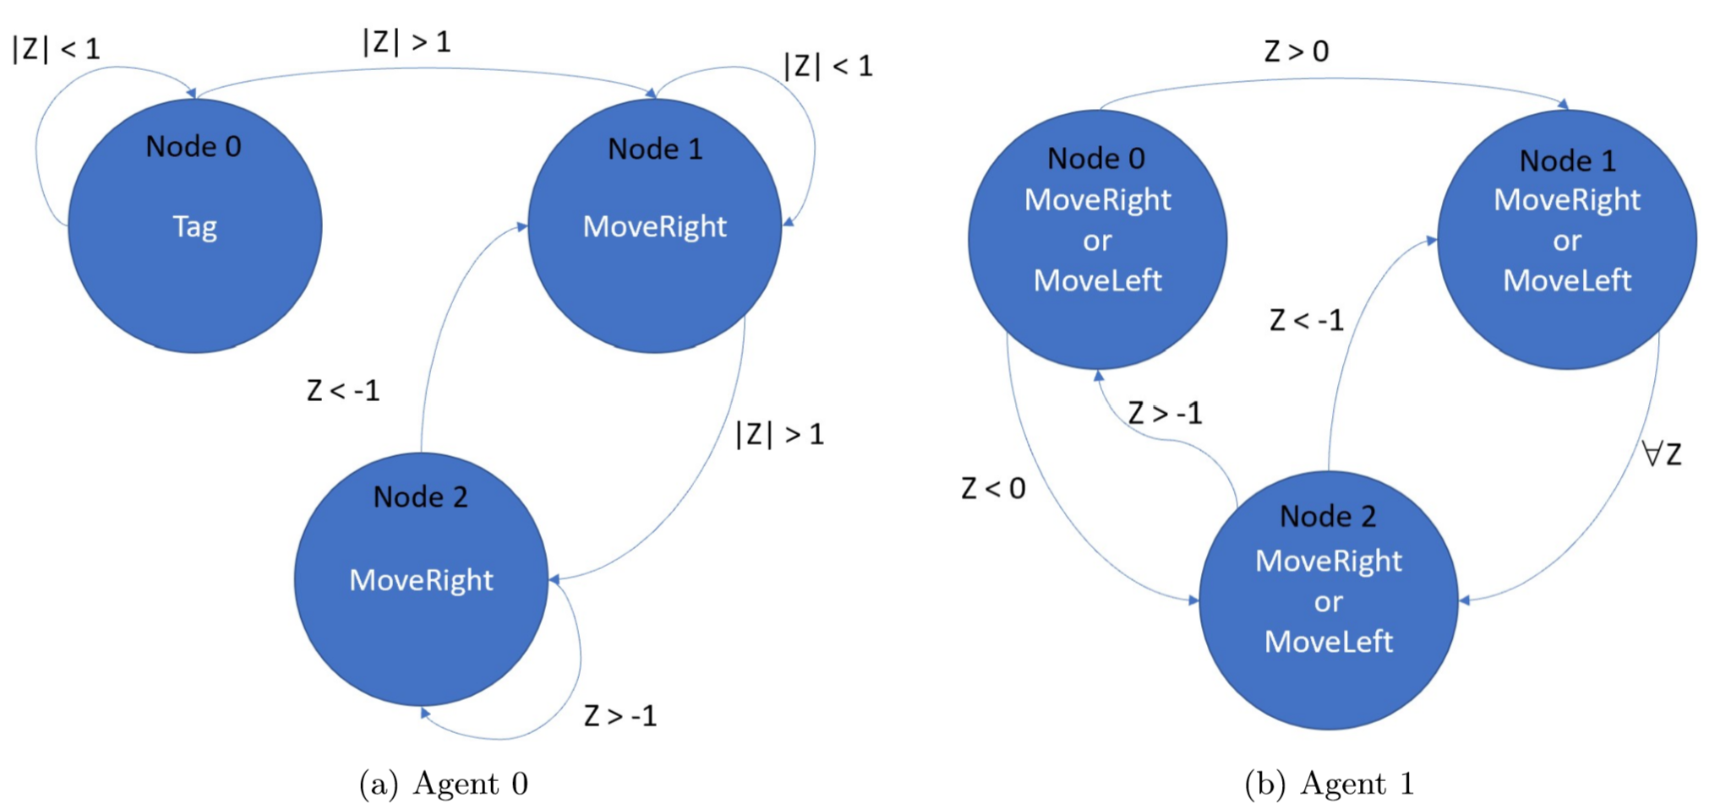
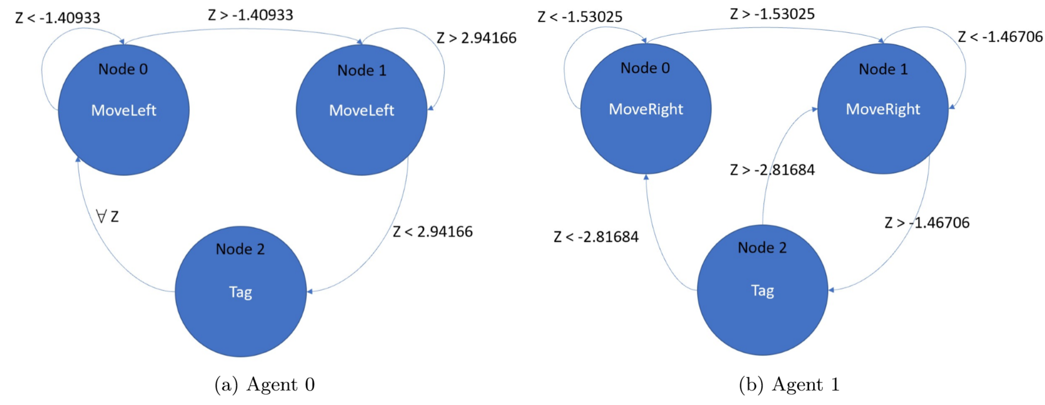
COGNet-DICE vs COG-DICE
COGNet-DICE
COG-DICE

Slide 15
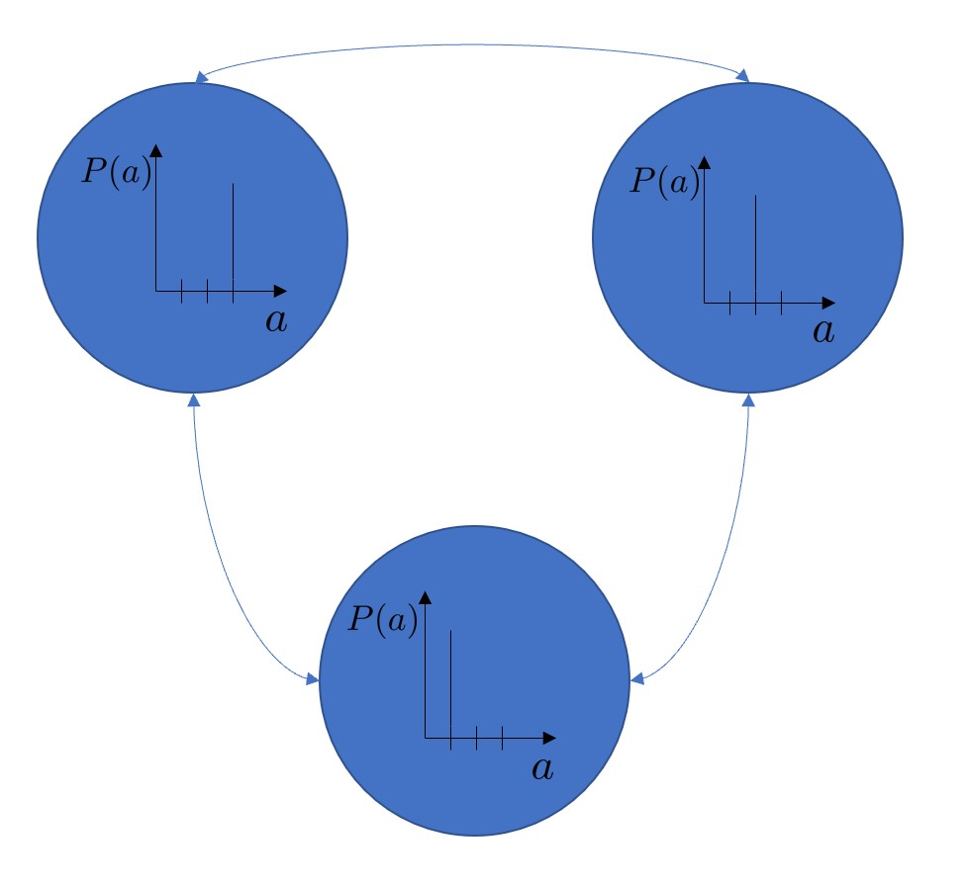
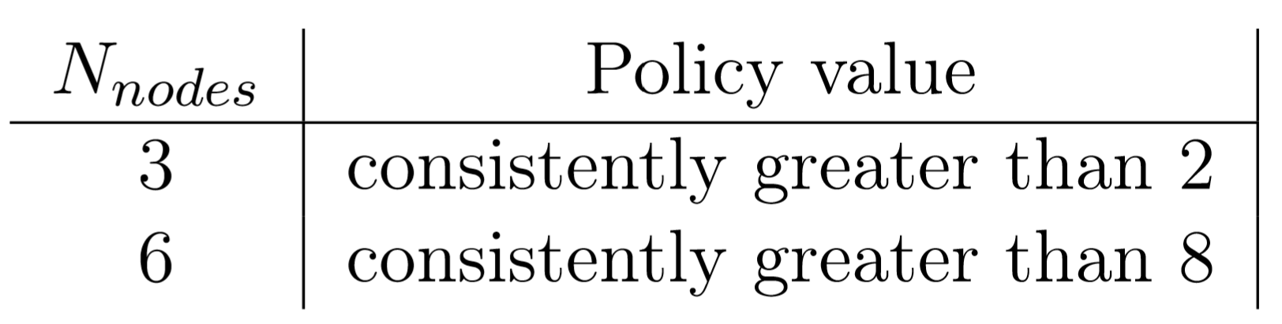
Separate training of perception only
Method
Results
Good results, but involves injection of human knowledge
Defeats the original intention of having a generic system, learning on its own based on mutual feedback from both sub-systems: the planning block and the perception block

Slide 16
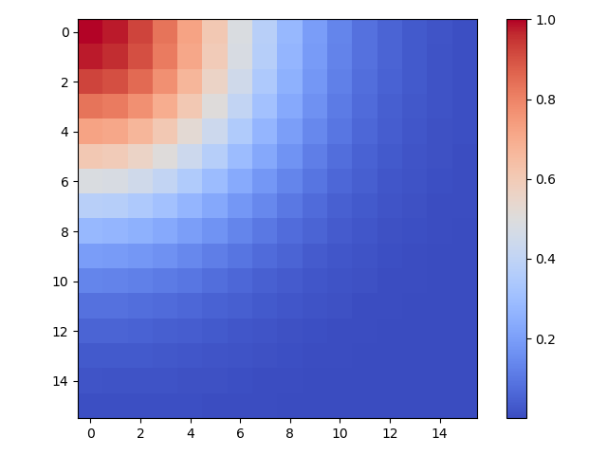
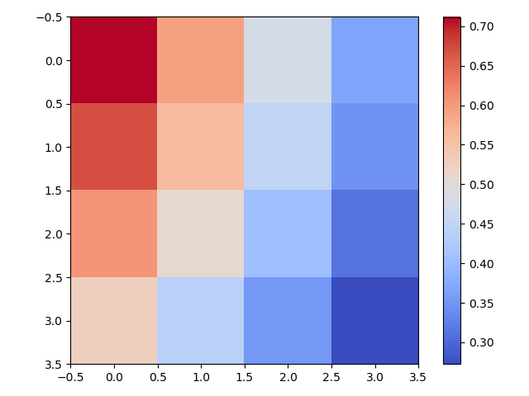

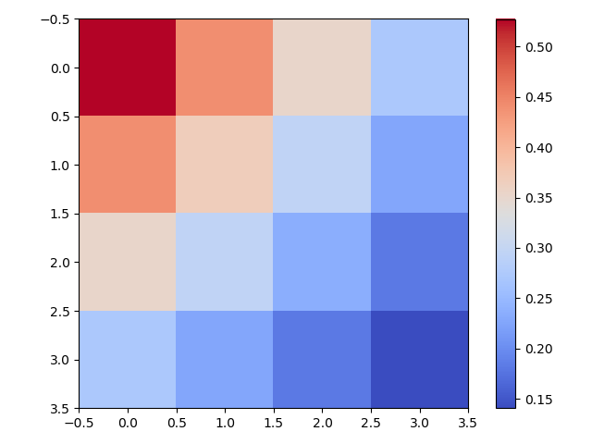
Heatmap Simulation
Intention: Emulate a static source localization problem in a 2D world
World Scene
Agent Perception

Slide 17
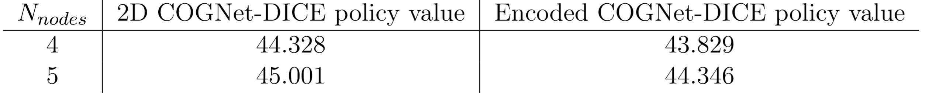
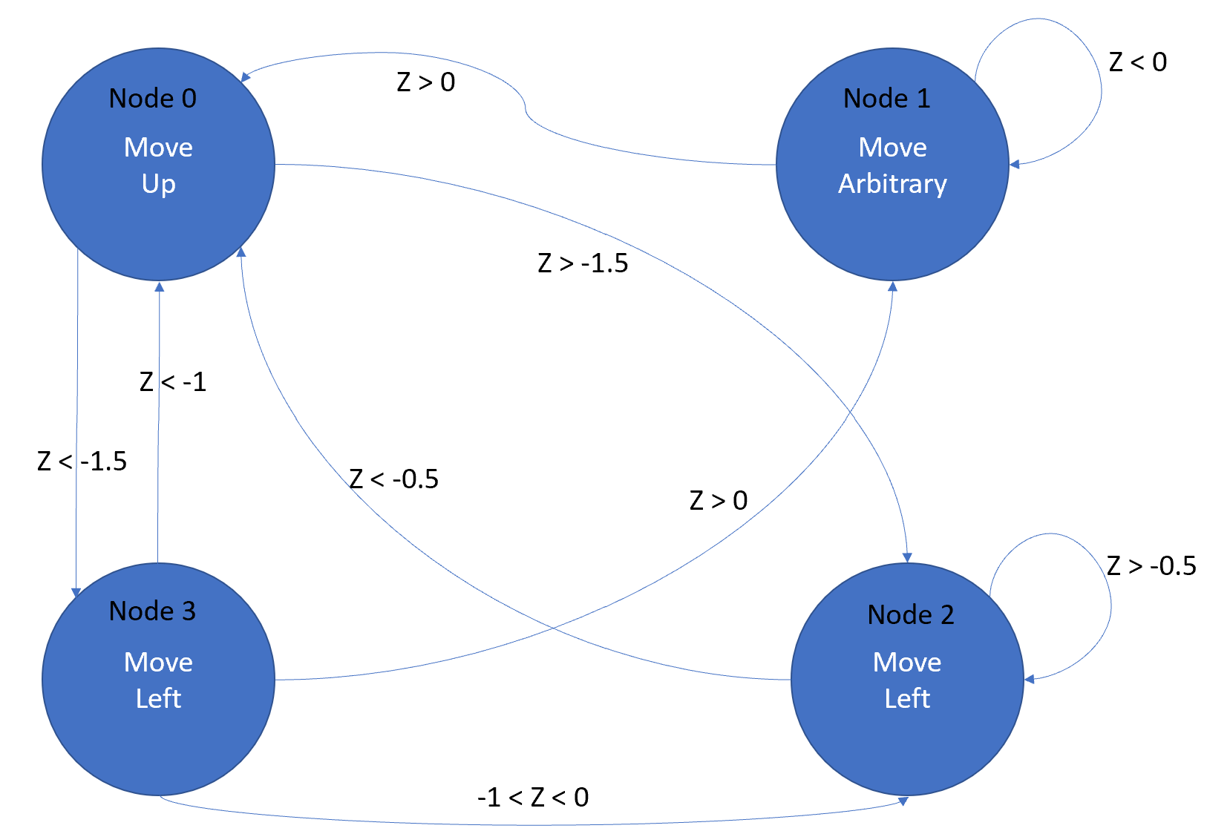
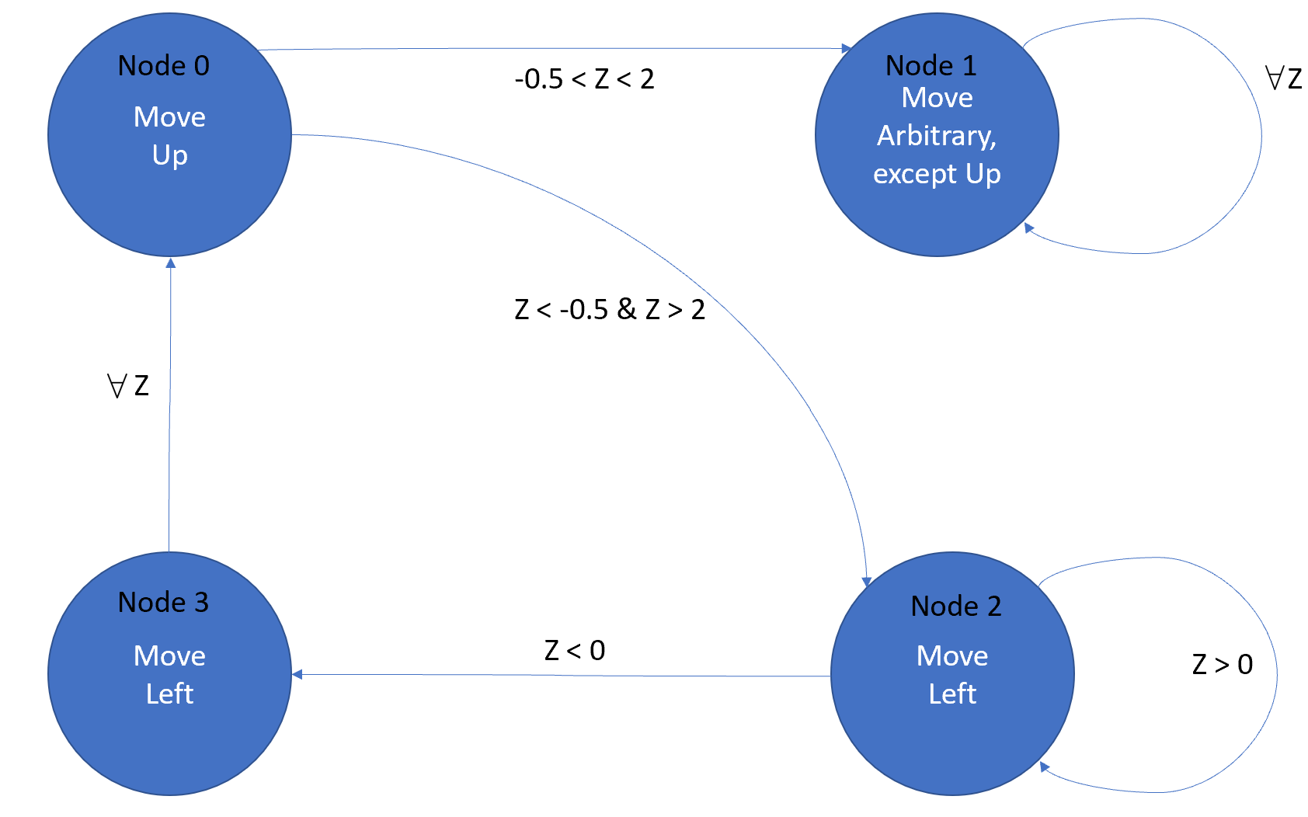
2D vs Encoded COGNet-DICE
Encoded COGNet-DICE (Agent 0)
Encoded COGNet-DICE (Agent 1)

Slide 18
Conclusions
1) Q: Can a graph-based direct cross-entropy algorithm be combined with neural networks and successfully trained to directly couple the tasks of perception and planning ?
A: Yes it can. Separate training also exhibited good results, but defeats the purpose of joint, end-to-end training.
2) Q: If yes, how does such an algorithm perform in the case of continuous observations and states ? In particular:
is such an algorithm useful for source localization problems with continuous observations and states ?
A: COGNet-DICE reaches state of the art results with more training time and more collected data points than other methods such as COG-DICE. Also, by using more nodes in a graph, it is easier to reach state of the art results in less time.
3) Q: Does this algorithm scale to very high-dimensional discrete inputs, such as images, when we use a lossy compression scheme derived with the help of a Variational Autoencoder ?
A: Yes, the algorithm does scale to higher dimensions using a Variational Autoencoder, and moreover: the Variational Autoencoder helps coping with noisy observations as well.

Slide 19

Questions

Slide 20
References
[1] The game of Chess: https://en.wikipedia.org/wiki/Chess accessed on the 15th of June 2020
[2] The game of Go: https://en.wikipedia.org/wiki/Go_(game) accessed on the 15th of June 2020
[3] Perception from perspective: https://www.braingymmer.com/en/blog/perception/ accessed on the 15th of June 2020
[4] Rolfs, M., 2015. Attention in active vision: A perspective on perceptual continuity across saccades. Perception, 44(8-9), pp.900-919.
[5] Oliehoek, F.A. and Amato, C., 2016. A concise introduction to decentralized POMDPs (Vol. 1). Springer International Publishing.
[6] First real photo of a black hole taken in 2019: https://www.nasa.gov/mission_pages/chandra/news/black-hole-image-makes-history accessed on the 16th of June 2020
https://textpro.me/matrix-style-text-effect-online-884.html was accessed on the 16th of June 2020 to generate matrix style text effects on slide 11
https://codepen.io/Mamboleoo/pen/obWGYr was accessed on the 15th of June 2020 to generate particle style text effects on slide 12
Cartoon character Jerry on slide 13 was taken from https://seeklogo.com/vector-logo/75382/jerry accessed on the 15th of June 2020

